Slide 1
Guru Gobind Singh College of Engineering and Research Centre, Nashik.
Department of Computer Engineering
Academic Year 2024-25
Project Review – II.I II.II
Group ID- G8
Guide Name : P. K. Bachhav
Roll No. | Name of Student
B- 97 | Ayesha Shaikh
B- 86 | Pooja Gupta
B- 98 | Shiba Shaikh
A- 34 | Anushka Jadhav

Slide 2
Title : AI Presentation Tool Using Gesture Recognition
Feasibility Study :
1. Technical Feasibility:The project primarily depends on technologies such as gesture recognition, voice commands, and integration with presentation software.
2. Operational Feasibility:This project has clear, practical applications in educational, corporate, and public speaking environments.
3. Economic Feasibility:The financial cost of this project is low since it leverages open-source libraries (OpenCV, MediaPipe, TensorFlow, etc.), and most development work can be done using free tools like PyCharm or VS Code.
4. Legal Feasibility:The project involves the integration of various APIs (Google Speech API) and open-source software (OpenCV, MediaPipe). Licensing issues must be addressed, but given that most of the tools used are available under permissive licenses, there are no significant legal barriers.
5. Time Feasibility:The project timeline is divided into four phases: Research, Design, Development, and Testing. Given a typical academic year of around 8-9 months, the project is feasible within the provided timeline:

Slide 3
Requirement Analysis
1. Functional Requirements:
Gesture Recognition Features
Voice Commands Integration
Presentation Control
Accessibility Features
2.Non- Functional Requirements:
Usability
Performance
Reliability

Slide 4
Requirement Analysis
3. Software Requirements
i.)Programming Languages
Python
Java
ii) Libraries & Tools
OpenCV
MediaPipe
pyautogui or pywin32
TensorFlow or PyTorch
•
•Google Speech API: For voice recognition and real-time subtitles.

Slide 5
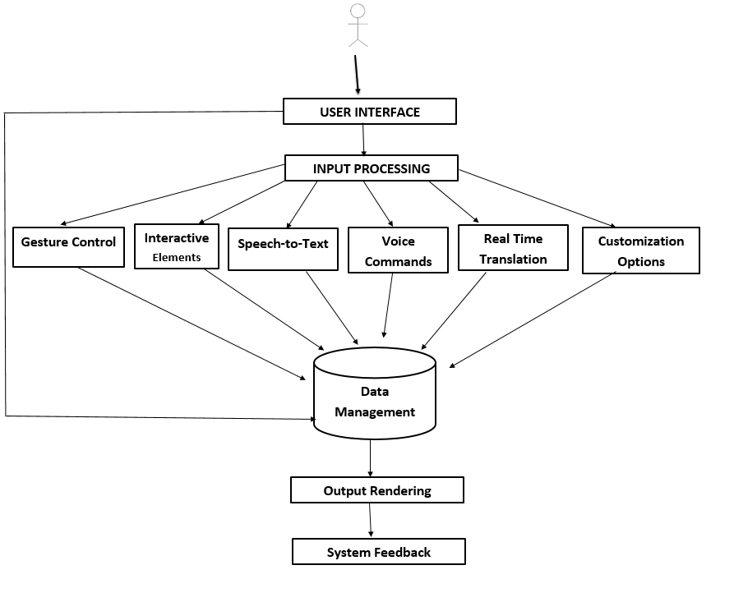
System Architecture

Slide 6
Methodology:
Phase 1: Research and Planning
Phase 2:Design and Prototyping
Phase 3:Core Development
Phase 4: Integration and Testing
Phase 5: Deployment and Maintenance

Slide 7
USE CASE DIAGRAM

Slide 8
CLASS DIAGRAM

Slide 9
OBJECT DIAGRAM

Slide 10
STATE DIAGRAM

Slide 11
ACTIVITY DIAGRAM

Slide 12
SEQUENCE DIAGRAM

Slide 13
Conclusion
In conclusion, the AI Presentation Tool Using Gesture Recognition represents a significant advancement in the field of human-computer interaction, offering an innovative solution for hands-free presentation control. By integrating advanced gesture recognition and voice command technologies, the tool enhances accessibility and interactivity, making it especially useful for individuals with physical disabilities and for environments where traditional input methods may be cumbersome.

